Slide 1
DBMS COURSE PROJECT
Team members:
Mahvish Ishaq-2103A51473
Sri Deekshitha-2103A51456
Jashvitha-2103A51362
Nasheer Fatima-2103A51179

Slide 2
Hospital Management System

Slide 3
ABSTRACT:
My project Hospital Database Management system includes registration of patients, storing their disease details into the system. It will also contain doctor’s information and will digitalize the whole billing system. It has the facility to give a unique id for every patient and stores the details of every patient and staff automatically. It includes a search facility to know the current status of each room. User can search availability of a doctor and the details of a patient using the id. And the whole process conducted by Administrator.

Slide 4
Introduction:
A Hospital Database Management System (HDMS) is a computer or web based system that facilities managing the functioning of a hospital or any medical set up. This system will help in making the whole functioning paperless. The hospital database includes all the necessary patient data. The disease history, test results, prescribed treatment can be accessed by doctors without much delay in order to make an accurate diagnosis and monitor the patient's health. It enables lower risks of mistakes. There are the various jobs that need to be done in a Hospital by the operational staff and Doctors. All these works are done on papers. Before All this work was done manually by the receptionist and other operational staff and lot of papers are needed to be handled and taken care of. Doctors have to remember various medicines available for diagnosis and sometimes miss better alternatives as they can’t remember them at that time.

Slide 5
Proposed system:
Now with the introduction of hospital database system it will be easy to maintain the data without any ambiguity. The hospital database includes all the necessary patient data.
The disease history, lab reports, prescribed treatment can be accessed by doctors without much delay in order to make an accurate diagnosis and monitor the patient's health. It enables lower risks of mistakes.
The project maintains two levels of users:
• Administrator.
• User Level-Data Entry Operator

Slide 6
Main facilities in this project are:
• Maintaining records of indoor/outdoor patients.
• Maintaining patient’s test and examinations details.
• Providing different test facilities to a Doctor for doctor for diagnosis of a patients.
• Maintaining patient’s prescription, medicine and diet advice details.
• Providing billing details for indoor/outdoor patients.
• Results of tests, prescription, precautions and diet advice will be automatically updated in the database.
• In this project collection of data in form different pathology labs.
• Related test reports, patient’s details report, billing reports can be generated as per user requirements.
• User or administrator can search a patient’s record by his id.

Slide 7
Existing system:
There are the various jobs that need to be done in a Hospital by the operational staff and Doctors. All these works are done on papers. Before All this work was done manually by the receptionist And other operational staff and lot of papers are needed to be handled and taken care of. Doctors have to remember various medicines available for diagnosis and sometimes miss better alternatives as they can’t remember them at that time.

Slide 8
Objectives:
Main objectives of a Hospital Management System are:
Design a system for better patient care. Reduce hospital operating costs. Provide MIS (Management Information System) report on demand to management for better decision making. Better co-ordination among the different departments. Provide top management a single point of control. Hospital management System handles activities of major departments in a hospital like:
1.Front Office/OPD Management
2. Patient management (scheduling, registration and long-term care)
3. Patient care management and departmental modules (radiology, pharmacy and pathology labs)
4. Investigative Labs
5. Billing
6. Medical Stores
7. Financial Accounting (billing, insurance processing, materials management, accounts payable/receivable, payroll and general ledger)8. Payroll

Slide 9
Product functions: SOFTWARE REQUIREMENTS:
i. A device (Computer/laptop)
ii. Memory (RAM): Minimum 2GB RAM
iii. Processor: Minimum 1GHZ; Recommended 2GHZ or more.
iv. Hard disk – 40 GB; Recommended 64 GB or more.
v. Ethernet connection (LAN) or, a wireless adapter (Wi-Fi)

Slide 10
HARDWARE REQUIRMENTS:
i. A database like DBMS to store the list of authors and the articles.
A web browser like Chrome, Mozilla Firefox etc.
iii. Operating System – Windows, Linux, macOS 32 bit and 64 bit

Slide 11
Advantages:
Patient self- service
Better customer experience
Clinic Management Automation
Market Stragtegy
Insurance claims processing
Improved processes
Digital Medical Records
Staff interaction
Facility Management
Financial control and tax planning

Slide 12
Future Enhancements:
The proposed system is Hospital Management System . We can enhance this system by including more facilities like pharmacy system for the stock details of medicines in the pharmacy. Providing such features enable the users to include more comments into the system.
Limitations:
The size of database increases day-by-day , increasing the load on the database back up and data maintenance activity.
Training for simple computer operations is necessary for the users working on the system.

Slide 13
Conclusion:
Taking into account all the mentioned details, we can make the conclusion that the hospital management system is the inevitable part of the lifecycle of the modern medical institution. It automates numerous daily operations and enables smooth interactions of the users. Developing the hospital system software is a great opportunity to create the distinct, efficient and fast delivering healthcare model. Implementation of hospital management system project helps to store all the kinds of records, provide coordination and user communication, implement policies, improve day-to-day operations, arrange the supply chain, manage financial and human resources, and market hospital services. This beneficial decision covers the needs of the patients, staff and hospital authorities and simplifies their interactions. It has become the usual approach to manage the hospital. Many clinics have already experienced its advantages and continue developing new hospital management system project modules.

Slide 14
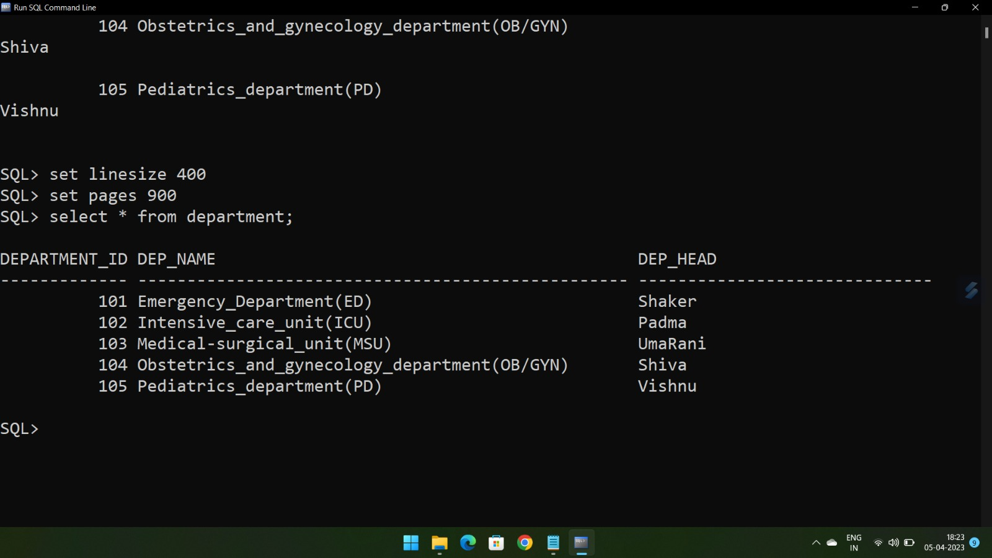
Outputs:

Slide 15
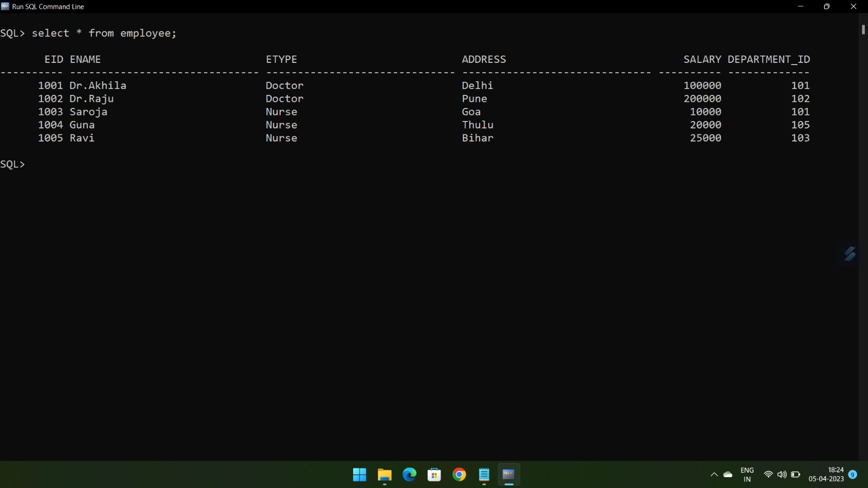

Slide 16
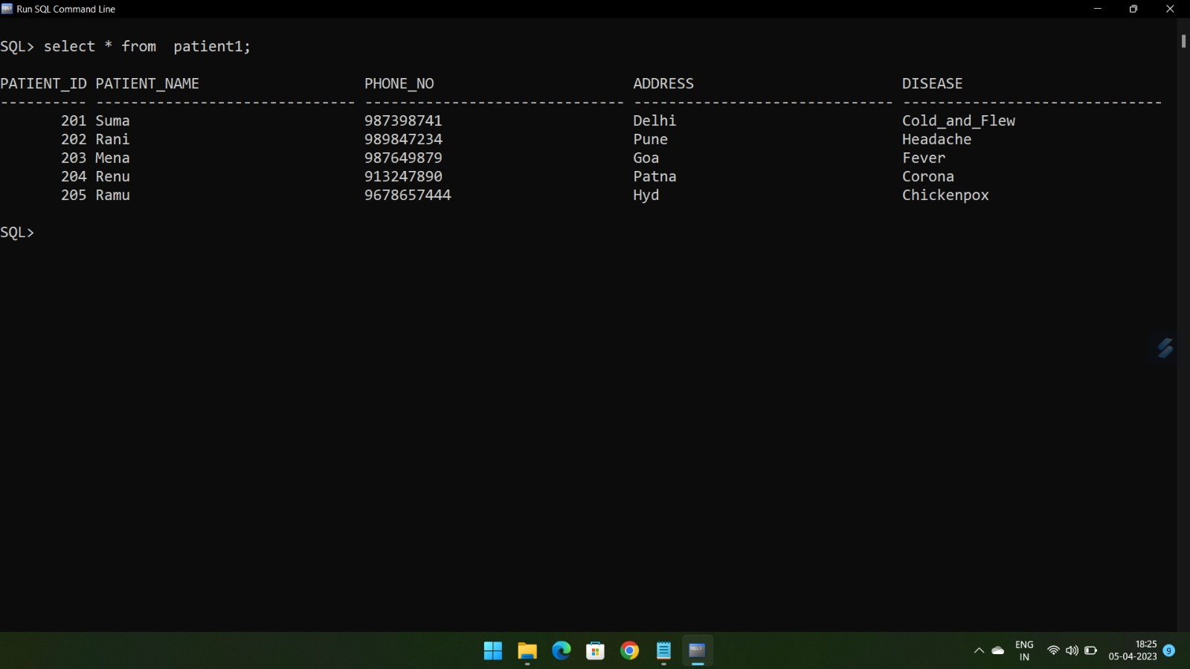

Slide 17
